Slide 1
MY SQL Project Sales Data Report
DATA ANALYTICS
Presented by
Vivek mali

Slide 2
Problem Statement
The dataset contains transactional sales data that records product-wise and region-wise performance across different sales channels and customer segments. The goal is to analyze this data to uncover insights about sales trends, product performance, and revenue generation patterns over time.
Specifically, this analysis aims to identify:
Which products and regions contribute most to total revenue.
How sales vary by channel (online vs. offline) and customer type.
The performance of individual salespersons.
Seasonal or time-based sales patterns that could inform future planning.
This problem focuses on developing a data-driven understanding of overall sales performance, supporting decisions related to marketing strategies, inventory management, and resource allocation.

Slide 3
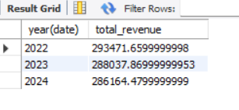
1.Write a query to display total sales revenue for each year. select year(date),sum(Revenue) as total_revenue from sale group by year(date);

Slide 4
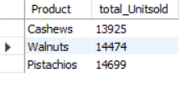
2.Retrieve the top 3 products based on total units sold across all 3 years. select Product,sum(Units_Sold) as total_Unitsold from sale group by Product order by total_Unitsold desclimit 3;

Slide 5
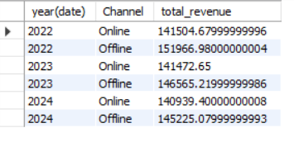
3.Display year-wise revenue generated from each Sales Channel select year(date),Channel,sum(Revenue) as total_revenue from sale group by year(date),Channel;

Slide 6
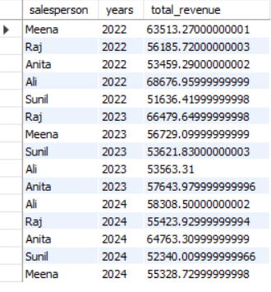
4.List the top-performing salesperson for each year based on revenue. select salesperson, years ,sum(Revenue) as total_revenue from sale group by years,salesperson;

Slide 7
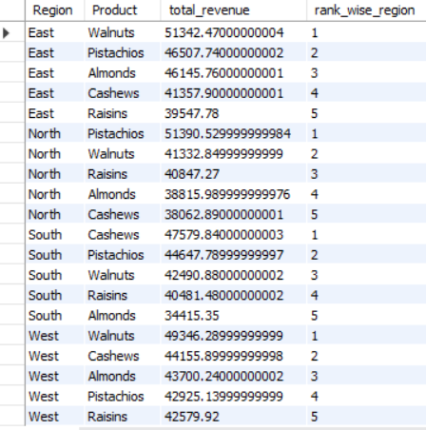
5.Using a window function, rank the products by revenue within each region. select Region,Product,sum(Revenue) as total_revenue,rank() over(partition by Region order by sum(Revenue) desc) as rank_wise_region from sale group by Region,Product ;

Slide 8
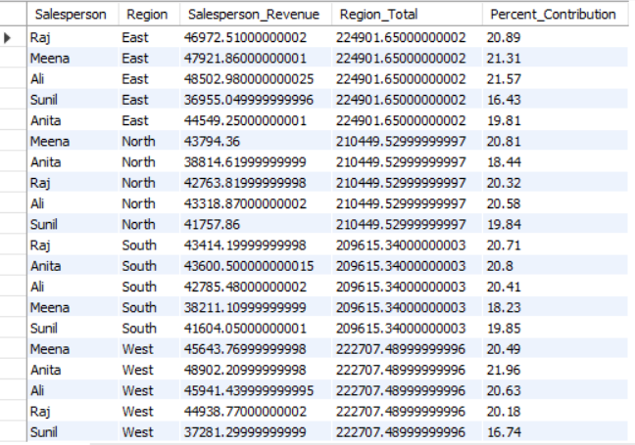
6.Display each salesperson’s percent contribution to their region’s total sales using SUM() OVER. select salesperson, region, sum(revenue) as salesperson_revenue, sum(sum(revenue)) over (partition by region) as region_total, round(100 * sum(revenue) / sum(sum(revenue)) over (partition by region), 2 ) as percent_contributionfrom sale group by salesperson, region;

Slide 9

7.Find the top-performing region based on total revenue using a subquery. select region, sum(revenue) as total_revenue from sale group by region having sum(revenue) = ( select max(region_total) from ( select region, sum(revenue) as region_total from sale group by region ) t);

Slide 10
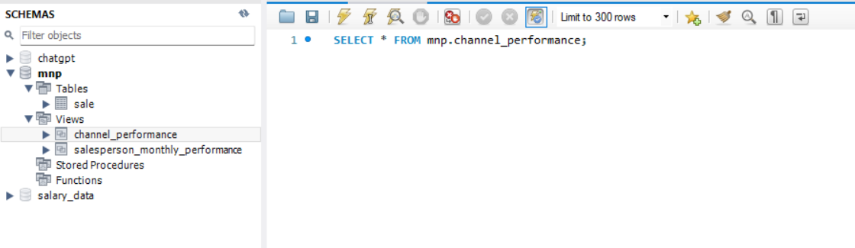
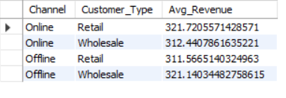
8.Create a view that stores average revenue per channel per customer type, and query it to find which combination gives the highest average. create view channel_performance as select channel,customer_type, avg(revenue) as avg_revenue from sale group by channel, customer_type;

Slide 11

9.Find products that perform better in online than offline channels. select product, sum(case when channel = 'online' then revenue else 0 end) as online_revenue, sum(case when channel = 'offline' then revenue else 0 end) as offline_revenue from sale group by product having online_revenue > offline_revenue;

Slide 12
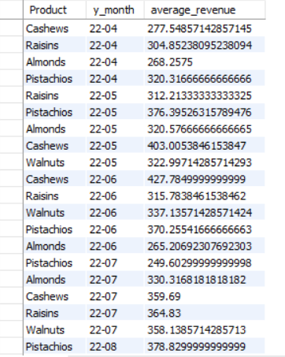
10.Identify seasonal trends: find average monthly revenue by product to detect seasonality. select product,date_format(date,'%y-%m') as y_month,avg(revenue) as average_revenue from sale group by product,y_month;

